Slide 1
MILAN:
Fashion Capital of the World
2023-1-PL01-KA121-SCH-000117151
Project number: 2023-1-PL01-KA121-SCH-000117151
Alessia Basile
Giulia Arruzzoli
Kinga Dyl
Paulina Krakowiak
Zuzanna Ozga

Slide 2
How Milan became the fashion capital?
1865
The Bocconi brothers open Italy’s first department store, revolutionizing the way luxury goods are sold to the wider public. Everyone in Milan is suddenly better dressed and encouraged to invest in accessible but beautifully made pieces.
1958
Milan hosts its first fashion week.
1973
The big textile companies start eyeing up unknowns to create designs using their fabrics. These include ‘the three Gs’ – Gianni Versace, Giorgio Armani and Gianfranco Ferré.

Slide 3
How Milan became the fashion capital?
1975
Giorgio Armani launches his eponymous label with his first collection.
1978
Gianni Versace opens his first boutique and almost instantly becomes a sensation. Gianfranco Ferré shows his first women’s collection the same year.
2009
Milan is officially named the fashion capital of the world.

Slide 4
MILAN FASHION WEEK
Milan Fashion Week is an event that no notable fashion house or designer misses, which signifies its importance.
The event is the dream event of young designers wanting to showcase their skills to people worldwide. It is the significance attached that has made the event a premier event in the world of fashion.
Unlike other fashion events, Milan holds the fashion week twice a year to accommodate all the potential designers and fashion houses.
Holding fashion weeks twice a year allows them the chance to showcase their talent in front of the world.

Slide 5
MICAM
Micam is an international event promoted by the trade association of Italian footwear manufacturers Assocalzaturifici, it is the most important trade fair and meeting point in the world for operators in the footwear sector.
The event takes place in Milan twice a year, in February and September, at the Fiera Milano Rho exhibition centre, presenting the following year's autumn/winter and spring/summer collections respectively.

Slide 6
MILANO UNICA EVENT
Milano Unica is one of the top events which will show European fabrics and accessories. The show will showcase complete range of products and services. Milano Unica is a biggest event which deals with the finest quality products from Italy and Europe. In the show, world acclaimed manufacturers and companies of Italy and Europe will demonstrate their latest and innovative product line in the show.
Milano Unica allows young and upcoming designers to showcase their designs and art.

Slide 7
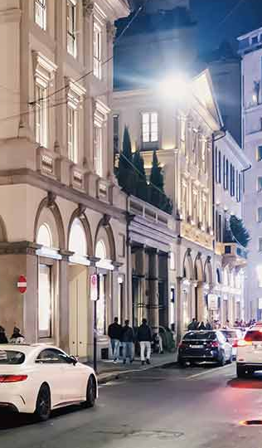
VIA MONTE NAPOLEONE
Via Monte Napoleone, also spelled Via Montenapoleone, is an upscale shopping street in Milan, Italy, Europe's most expensive street and the second most expensive street in the world after Fifth Avenue in New York City . Part of Milan's fashionable Quadrilatero d’Oro, Via Monte Napoleone is home to some of the most exclusive shoemakers and designers from Italy and across the world.

Slide 8
GOLDEN RECTANGLE
Il Quadrilatero d’Oro, Golden Rectangle in English, is Milan’s most famous shopping place. It covers four different streets such as via Montenapoleone, via Borgospesso, via Della Spiga and via Sant’ Andrea. This is Milan’s fashion district and one of the most up-market areas in the whole world. When walking down the Golden Square you will find the most beautiful boutiques filled with jewelry, design pieces and furnishing delights. The Golden Square is Milan’s fashion and shopping heart and its main artery is via Montenapoleone with it chic and very expensive boutiques.

Slide 9
THANK YOU ! ☺
The project has been funded with support of European Commission. This publication reflects only the views of the author, and the Commission cannot be held responsible for any use which may be made of the information contained therein.

